Slide 1

Measuring the Unseen: Exploring the World of Distance Sensors with Arduino
Minor Project Presentation
Submitted to
Shri Shankaracharya Technical Campus
Session: 2024-25
Guided by:
Dr. Abha Choubey
Presented By:
Adarsh Mishra
Shubham Das
Ishaan Pandey
Priyansh Dubey

Slide 2
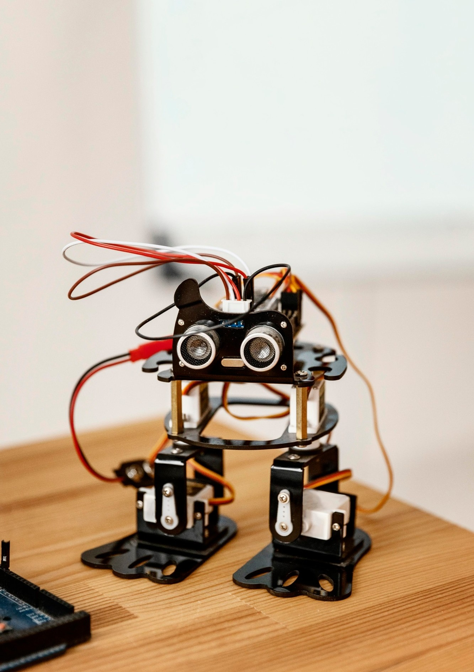
Agenda
Introduction
What are Distance Sensors
How Distance Sensors works
Popular Distance Sensors
Integrating Sensor With Arduino
Creative Project Ideas
Challenge and Solutions
Future Of Distance Sensing
Conclusion
References
Bibliography

Slide 3
In this presentation, we will explore the fascinating world of distance sensors using Arduino. These devices allow us to measure distances accurately and can be applied in various creative projects. Join us as we uncover how these sensors work and how they can enhance your DIY projects!

Slide 4
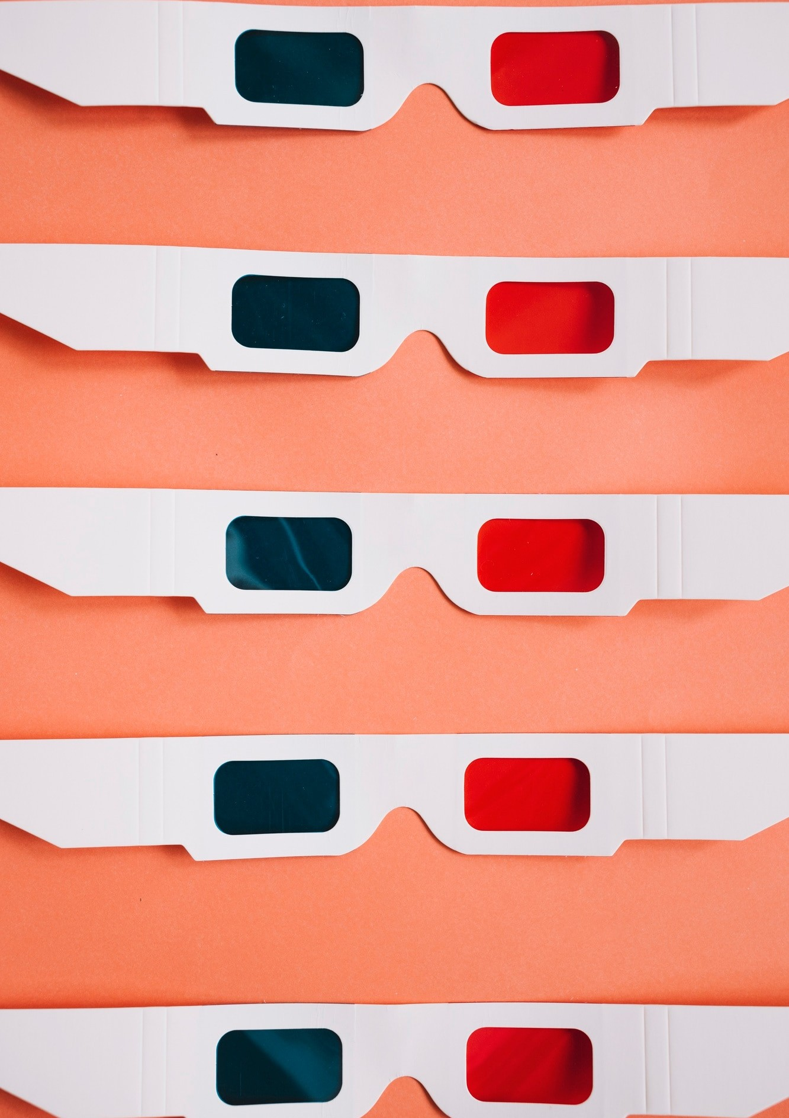
Distance sensors are devices that measure the distance between the sensor and an object. They can use various technologies like ultrasonic, infrared, or laser. Understanding their working principles is crucial for selecting the right sensor for your project.

Slide 5
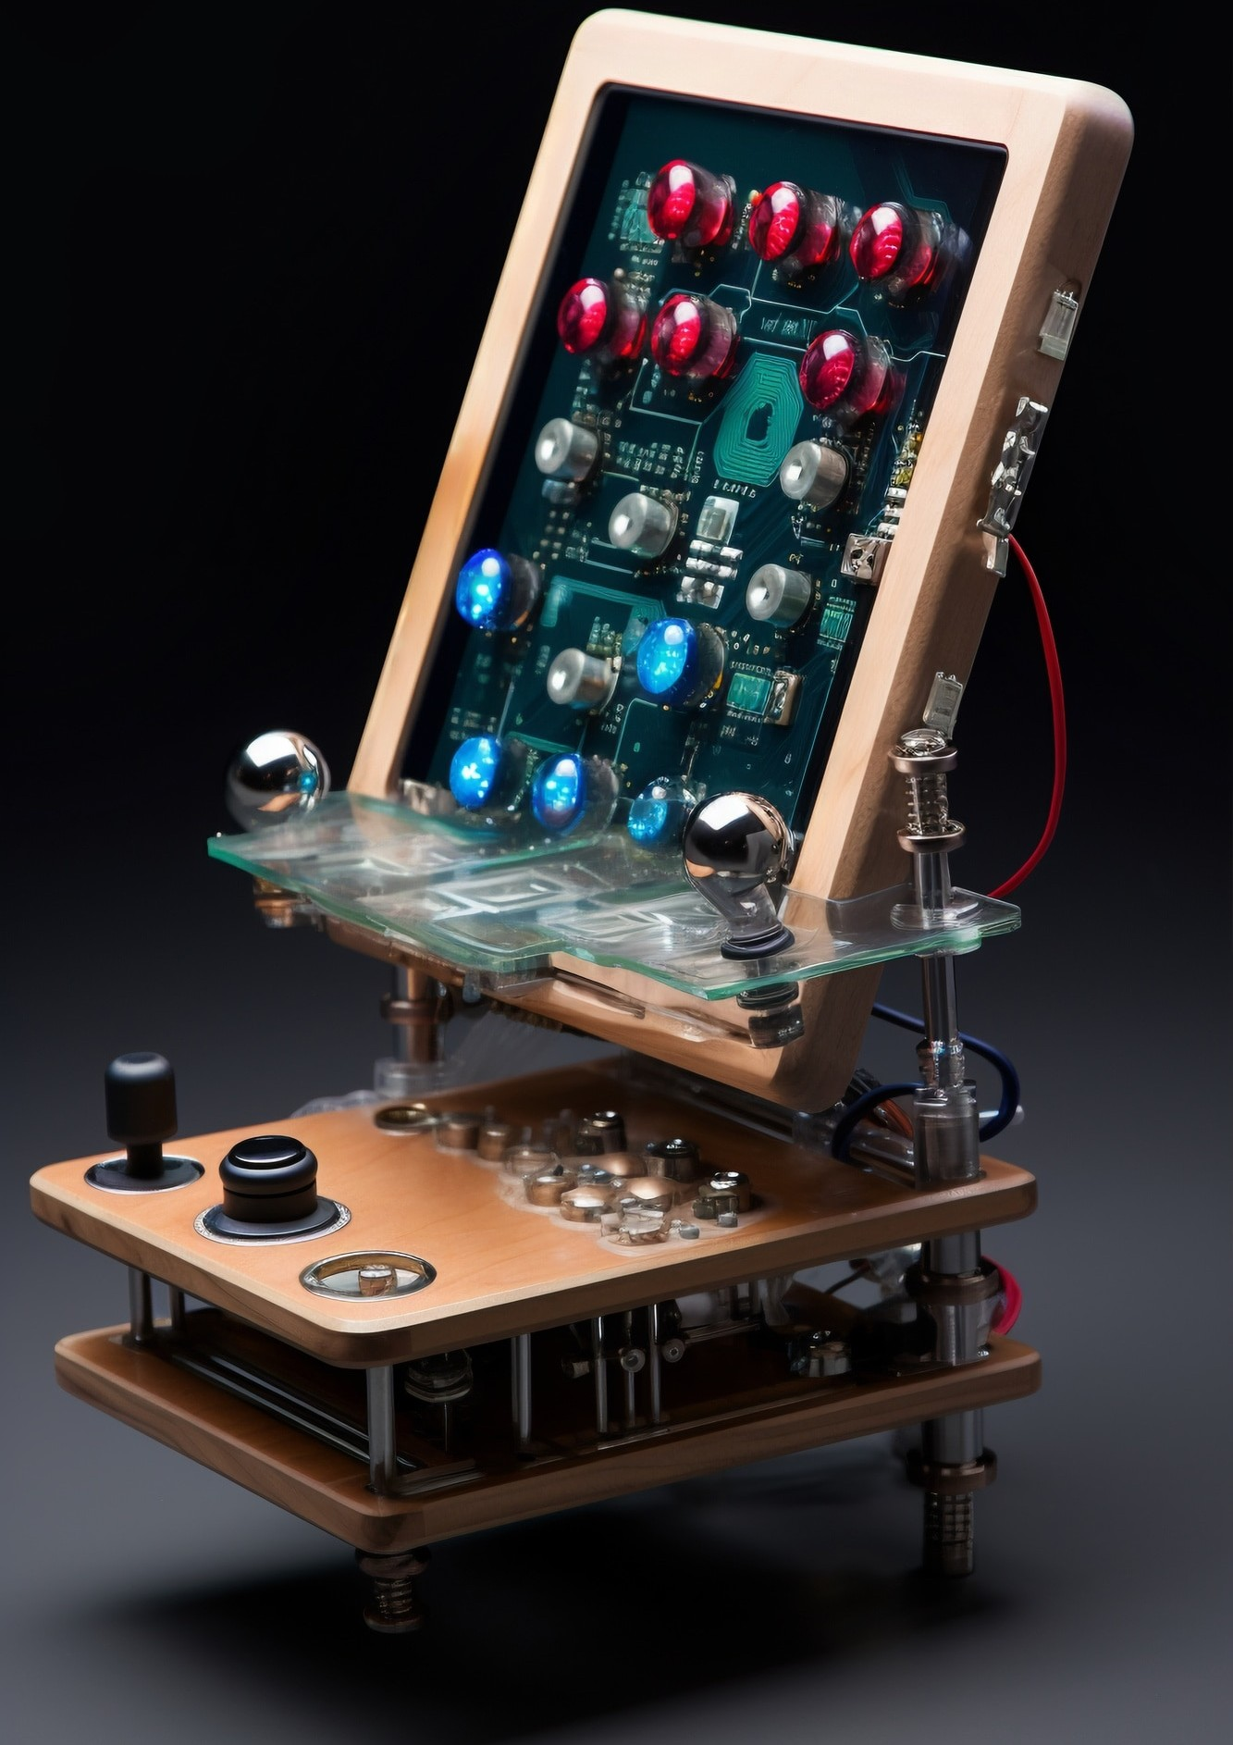
Most distance sensors operate by emitting a signal, which reﬂects off an object and returns to the sensor. The time taken for this signal to return is used to calculate the distance. This principle is used in ultrasonic and infrared sensors, among others.

Slide 6

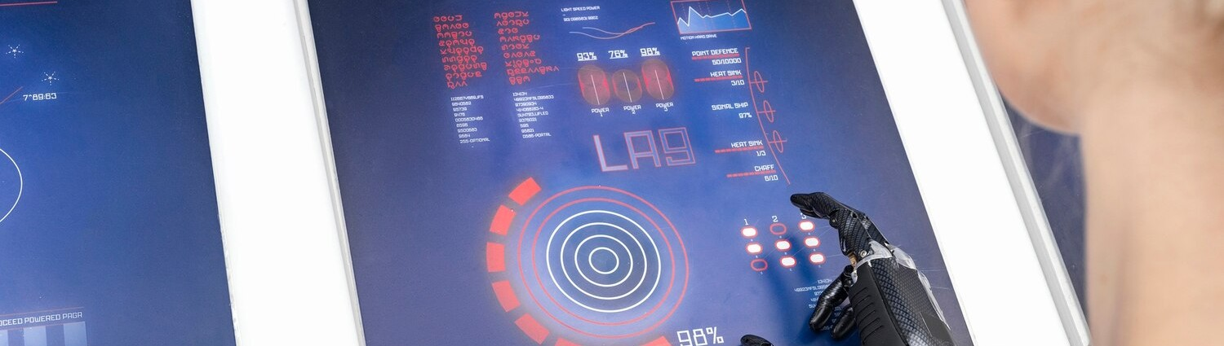
Some of the most popular distance sensors include the HC-SR04 ultrasonic sensor and the VL53L0X laser sensor. Each has its own strengths, such as accuracy, range, and response time. Choosing the right sensor depends on your speciﬁc application.

Slide 7
Integrating distance sensors with Arduino is straightforward. You can use simple libraries to read data and control other components based on distance measurements. This opens up a world of possibilities for automation and interactive projects.

Slide 8


Distance sensors can be used in various creative projects, such as obstacle-avoiding robots, automated doors, or even smart home systems. The only limit is your imagination! Let’s explore how to bring these ideas to life using Arduino.

Slide 9


While working with distance sensors, you may face challenges like interference, inaccurate readings, or environmental factors. Understanding these issues and knowing how to troubleshoot can make your projects more successful and reliable.

Slide 10
The future of distance sensing looks promising with advancements in technology. New sensors are being developed that offer improved accuracy, miniaturization, and cost-effectiveness. Keeping up with these trends can enhance your projects signiﬁcantly.

Slide 11

In conclusion, distance sensors are powerful tools that can enhance your Arduino projects. By understanding their principles, exploring creative applications, and overcoming challenges.
You can unlock endless possibilities in the world of technology. Thank you for your attention!

Slide 12
Bibliography
www.arduino.org www.beyondlogic.org www.wikipedia.org www.elementzonline.com
www.elementztechblog.wordpress.com

Slide 13
References
www.google.com
https:/ youtu.be/GHx_LwrdLhs?si=6kenkz3HozSIr8tt https:/ youtu.be/vf2lW4LkmMQ?si=ANOlnkKGL2s_wYdS https:/ youtu.be/EAeuxjtkumM?si=WoExr4RtJAZhbNRS

Slide 14

Thanks!

